Slide 1
Predicting Time Remaining of Laboratory Earthquake using Machine Learning
Xuan Qin, Ph. D.
Mentor: Raghunandan Patthar

Slide 2
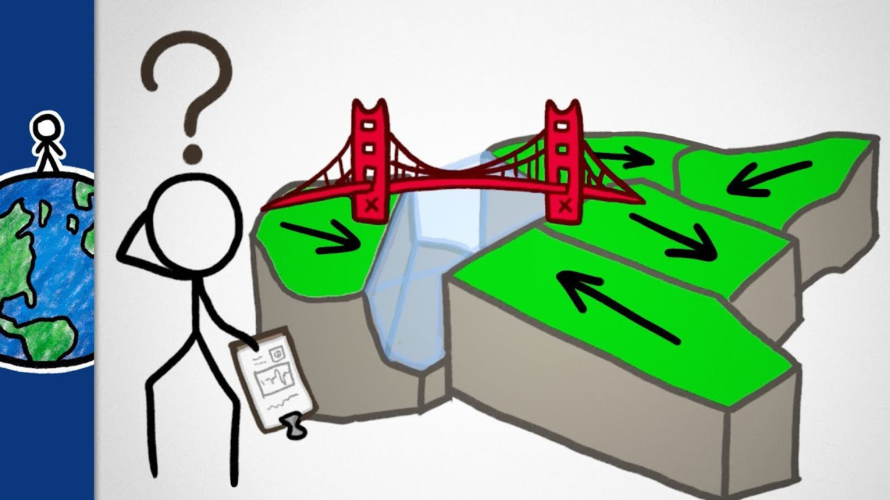
Background
Earthquake forecast is difficult
Empirical analysis versus physical principles
Slow earthquake
Found in recent twenty years
Releasing energy slowly
A wide spectrum of stick-slip
Providing insights into traditional earthquakes
So hard to predict
Notes:
Earthquake can cause severe damage. Geoscientists have been striving studying the earthquake physics and trying to predict when and how large of an earthquake. However, geologists society and earthquake scientists have never predicted a major earthquake.
Traditional methods generally look for trends or patterns that lead to probablilistic estimation of earthquake happening
3. Discovered only in the last 20 years, slow earthquakes are still a seismic puzzle. This type of earthquake seems can be predicted
A slow earthquake is a discontinuous, earthquake-like event that releases energy over a period of hours to months, rather than the seconds to minutes characteristic of a typical earthquake.
Slow earthquakes are characterized by a wide spectrum of fault slip behaviors and seismic radiation patterns that differ from those of traditional earthquakes. However, slow earthquakes and huge megathrust earthquakes can have common slip mechanisms and are located in neighboring regions of the seismogenic zone. The frequent occurrence of slow earthquakes may help to reveal the physics underlying megathrust events as useful analogs. Understanding the slow earthquakes helps to better predict the other earthquakes.

Slide 3
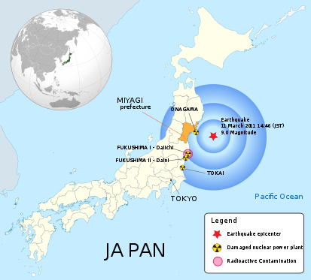
A precursor?
Magnitude: 9.0
Duration: 6 minutes
Tsunami & Nuclear disaster!
Nearly 20,000 killed!
However, two slow earthquakes nearby were observed in February 2011, one month ahead of the megathrust.
Tohoku Earthquake (3/11/2011)
Notes:
two quieter earthquakes began slowly creeping along the Japan Trench toward the point where the massive, megathrust quake would erupt a month later.
Image how many people’s lives and economic lost can be saved?

Slide 4
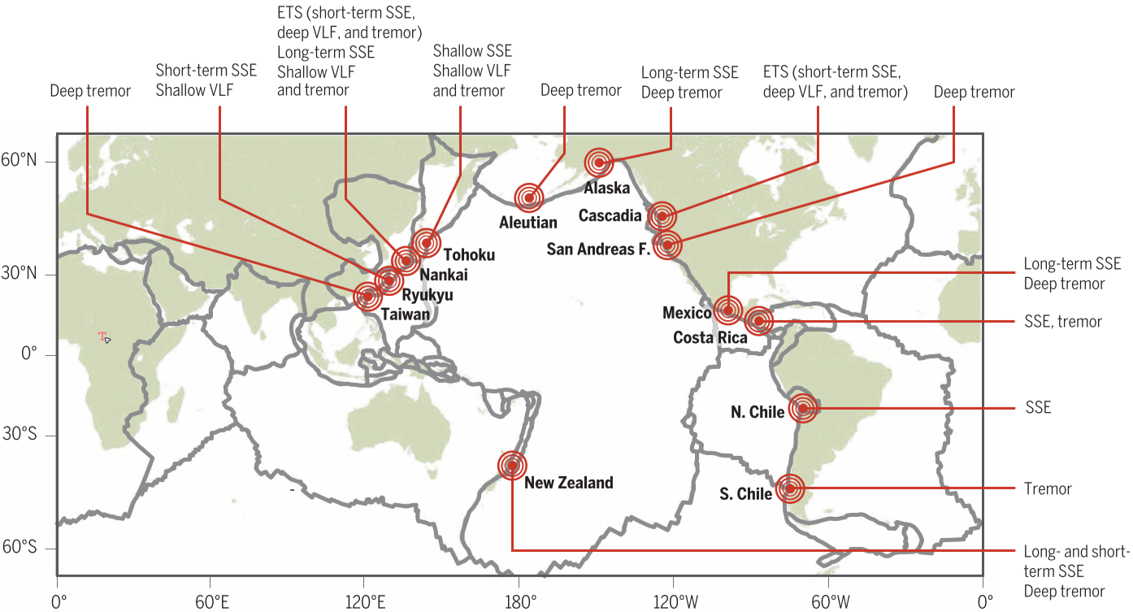
Who should concern?
Geoscientists and National Geological Survey
Residents near the fault zone
Oil/gas companies prevent from hazardous events during exploration and production
(Obara and Kato, 2016, Science)
Slow earthquakes observed in the pacific rim
Notes:
The map shows the global Earthquake belt, such as the pacific rim. There exist large amounts of population and heavy economic activity, such as California, Japan, and Indonesia.
an earthquake costs huge damage in people’s property, health and lives.. Due to the long-period earth’s activity and complex geomaterials’ properties.
With the rapid development in machin learning and data science, forecasting a specific mechanism-related earthquake, becomes possible.

Slide 5
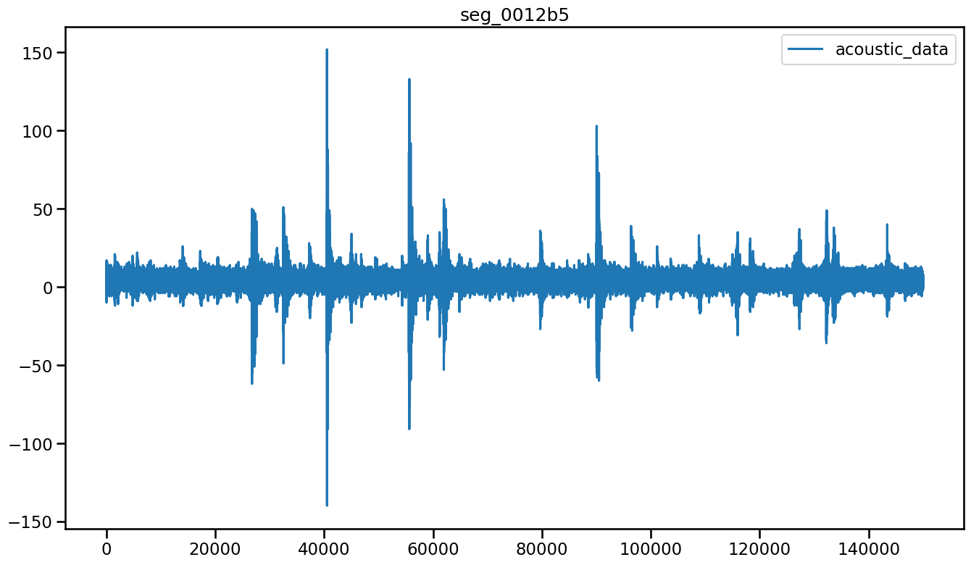
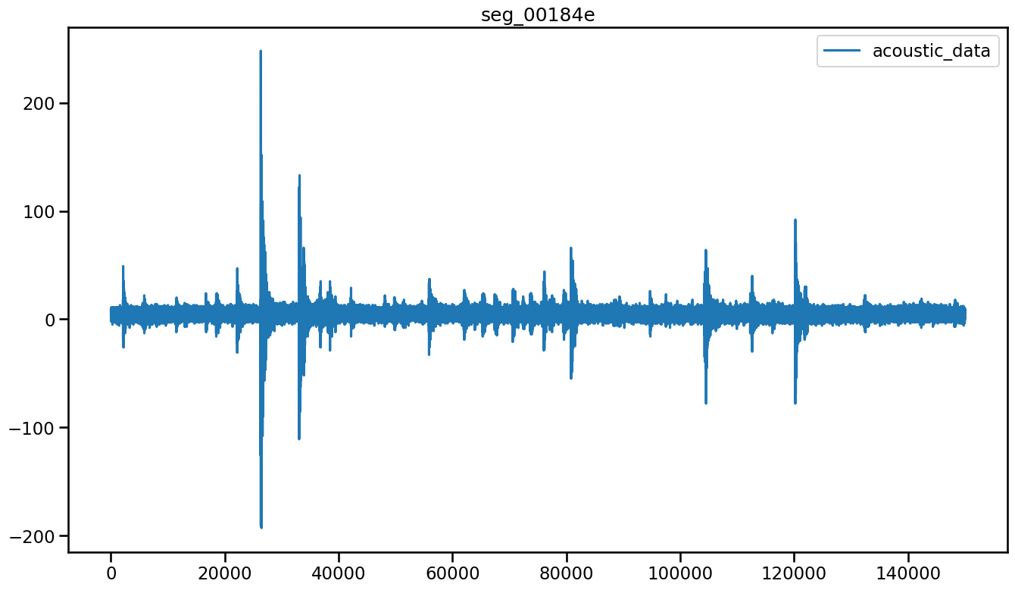
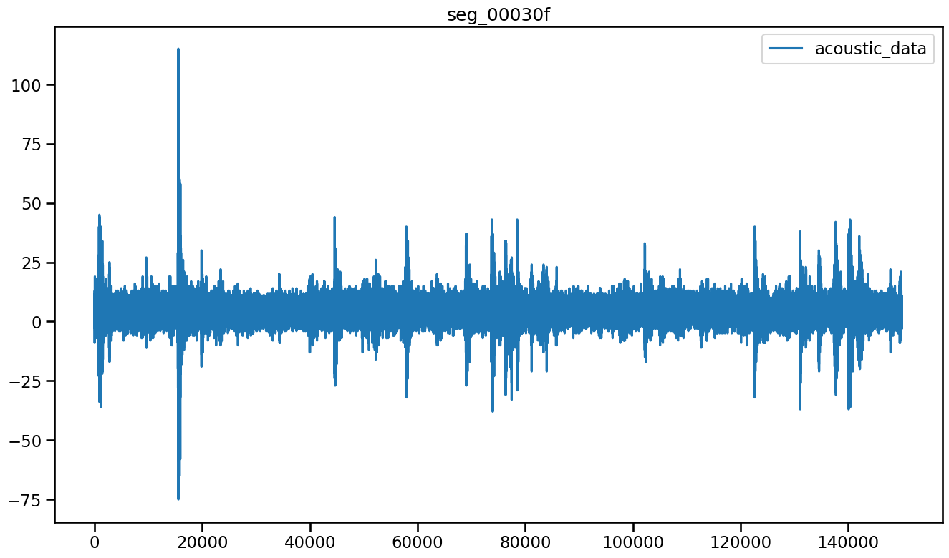
Objective
Using machine learning to forecast laboratory earthquake occurring time given a small piece of signal (~0.039 s)
What is the remaining time to failure?
Notes:
previously assumed to be statistical noise, reflects the increasing emission of energy before its sudden release during a slip event.

Slide 6
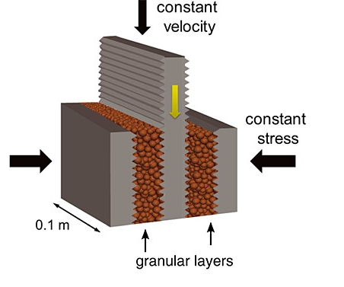
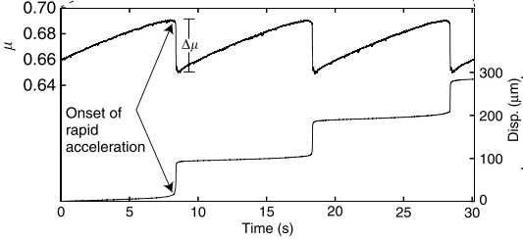
Experimental setting
Laboratory experiment simulating slow earthquakes
(Leeman et al., 2016)
Measured stick and slip
Repetitive stick and slip between granular layers and shear load
Notes:
slow earthquakes are caused by a variety of stick-slip and creep processes intermediated between asperity-controlled brittle and ductile fracture.[Asperities are tiny bumps and protrusions along the faces of fractures. They are best documented from intermediate crustal levels of certain subduction zones (especially those that dip shallowly — SW Japan, Cascadia,^{[6]} Chile)
Two fault gouge layers are sheared simultaneously while subjected to a constant normal load and a prescribed shear velocity. The laboratory faults fail in repetitive cycles of stick and slip that is meant to mimic the cycle of loading and failure on tectonic faults.

Slide 7
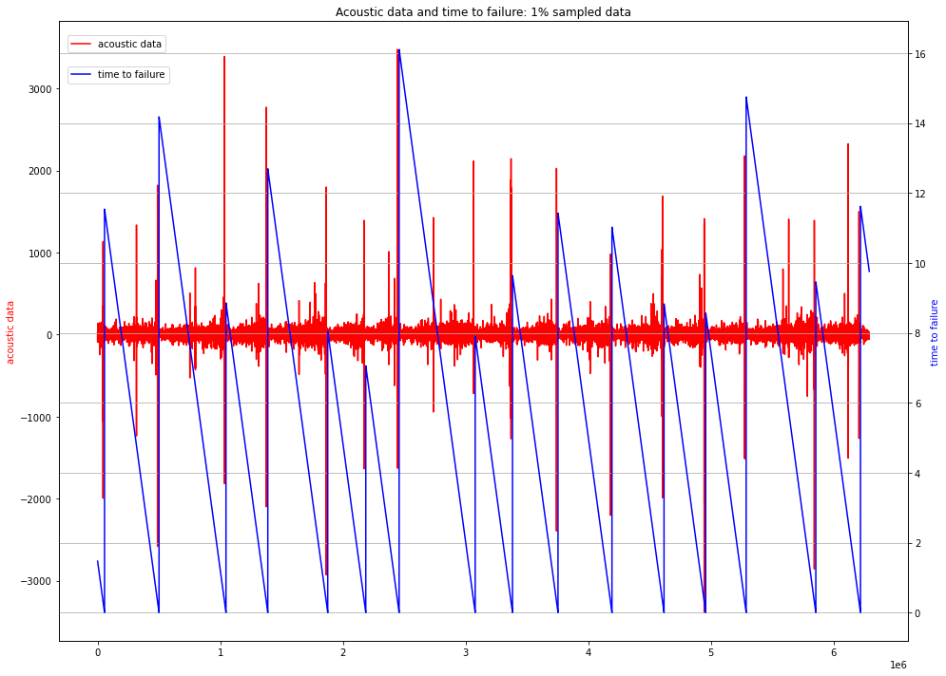
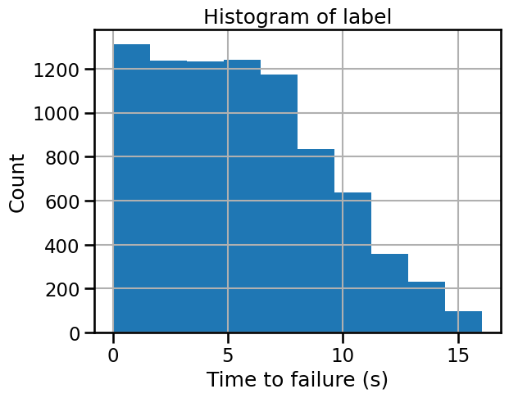
Raw data
Acoustic emission signal
(Imbalanced labels)
Label: Time to failure
A failure event
Sixteen failure events in total;
Considerably more aperiodic earthquake failures.
Notes:
We need to split the single file into
After split the dataset, we create about 8400 labels,
Assume each label is irrelevant, shuffle.

Slide 8
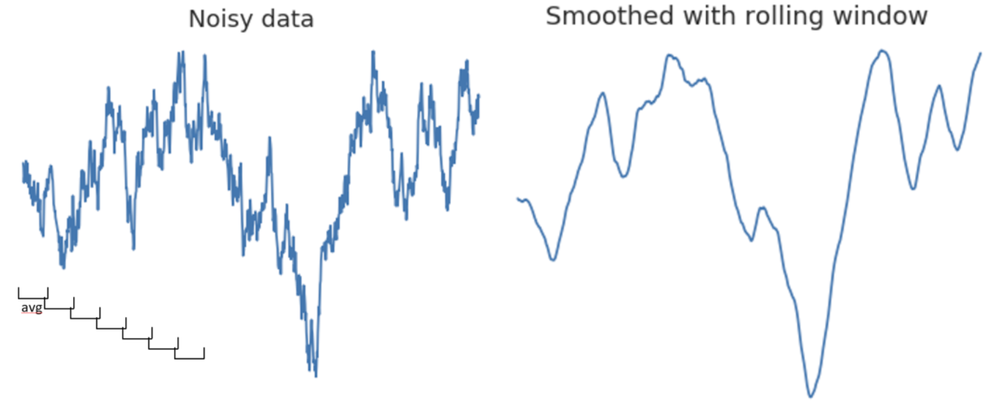
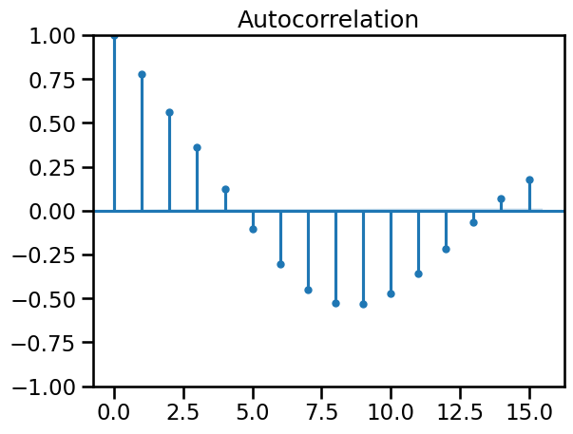
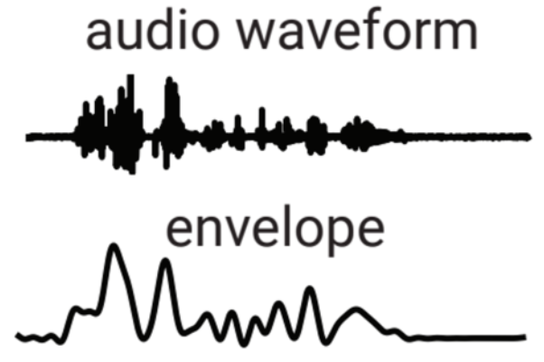
Feature engineering
Time & frequency domain features
Chunk statistics
Min, max, mean, kurt, skew, percentile
Rolling statistics (rolling functions + statistics)
Autocorrelation
Rectified energy
Spectrogram (windowed fft)
Centroids & bandwidth
Rolling statistics capture trend by suppressing noise
Trend following / Mean reversion
Raw waveform
Envelope
Notes:
Using a series features to represent 150 k points of signal in time-domain.
refers to the degree of correlation of the same variables between two successive time intervals.

Slide 9
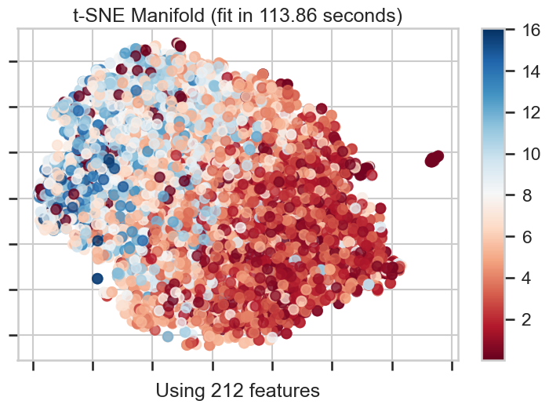
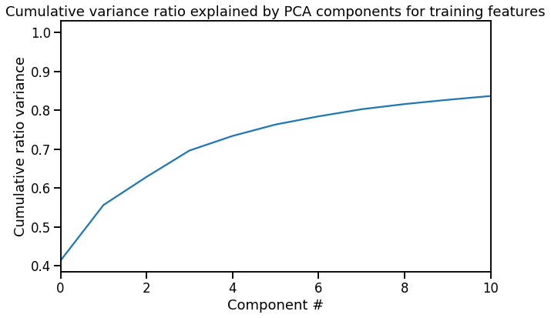
Training Data
ttf
PCA
t-SNE analysis
Notes:
Blender
t-distributed stochastic neighbor embedding

Slide 10
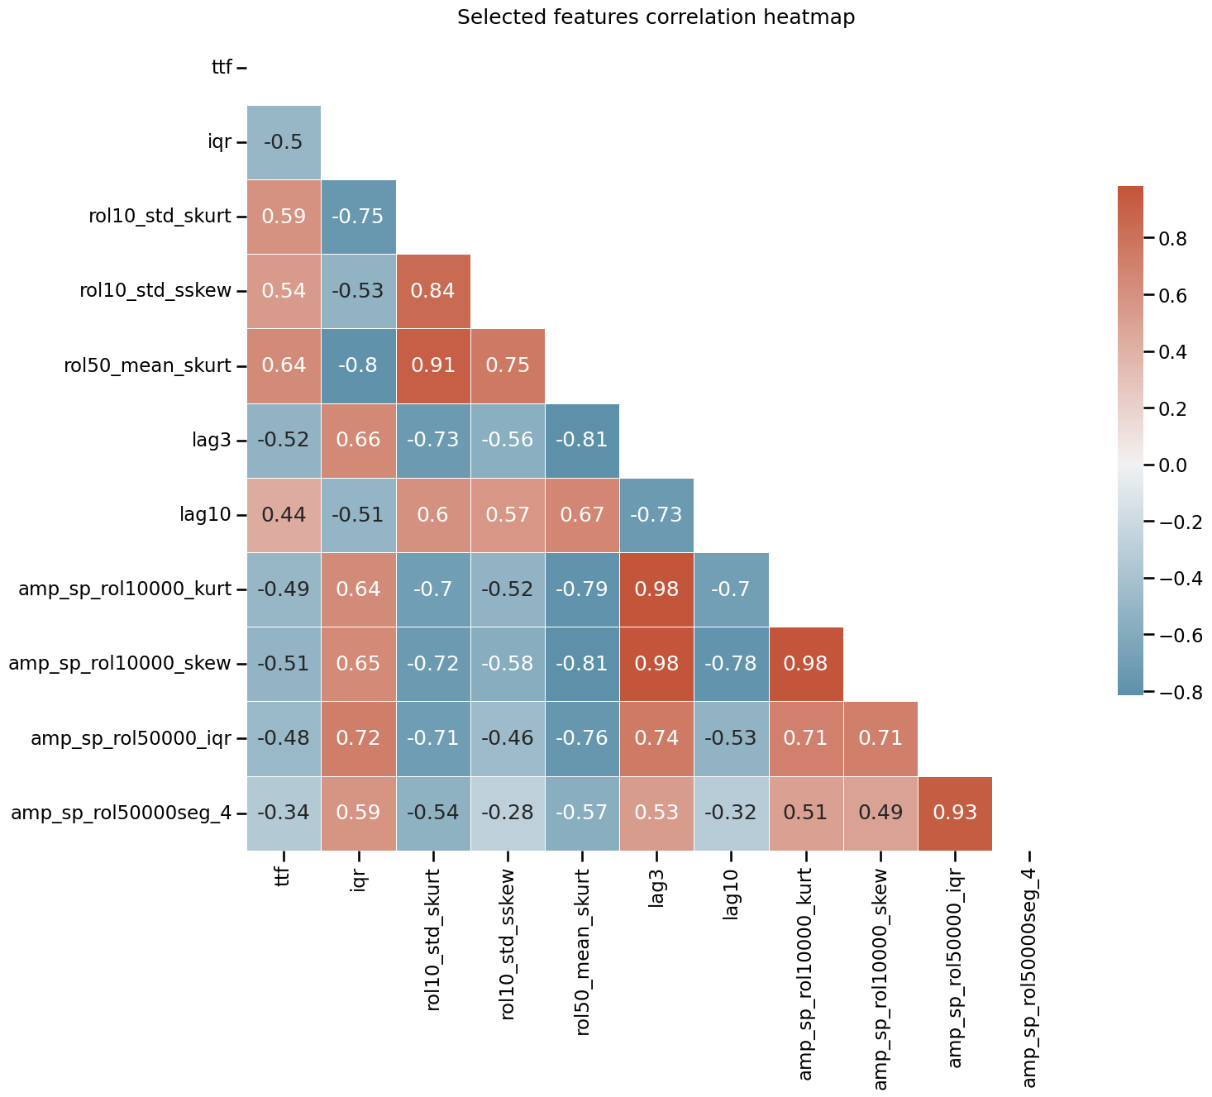
Selected feature’s correlation with labels
The correlation between a single feature and the label ranges from -0.6 to 0.6
How to build a model to enhance the correlation?
Label
Notes:
Correlation between a single feature and the label ranges from –0.6 to 0.6

Slide 11
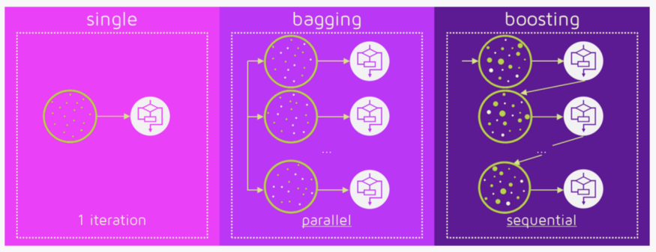
Ensemble methods
Bagging
Build each tree from a random subset of features
Trade high bias for a low variance
Handle highly correlated features well
Boosting
Train and get residuals
Leverage the patterns in residuals
Light GBM
Better accuracy
Lower memory usage & faster training speed
Single Tree
Easy to understand
Handle nonlinearity
Poor predictive accuracy
Notes:
Bagging is a simple ensembling technique . The Random Forest algorithm Generate bootstrap training samples and searches for the best feature among a random subset of features; Resample the data or features to train many tree models. Use model averaging, such as majority vote or nomal average. This results in a greater tree diversity, which (once again) trades a higher bias for a lower variance, generally yielding an overall better model.
The popularity of random forest is primarily due to how well it performs in a multitude of data situations. It tends to handle highly correlated features well, where as a linear regression model would not.
'Boosting' is the term for an ensemble method in which new models replace incorrect predecessors until no further improvements can be made. Gradient boosting, on the other hand, is a technique that makes new models to predict the error of previous ones, before collating the results for an ultimate prediction.
Gradient boosting: Each time we run a decision tree, we extract the residuals. Then we run a new decision tree, using those residuals as the outcome to be predicted. After reaching a stopping point, we add together the predicted values from all of the decision trees to create the final gradient boosted prediction.
LightGBM is a gradient boosting framework that uses tree-based learning algorithms. It is designed to be distributed and efficient with the following advantages:
Faster training speed and higher efficiency.
Lower memory usage.
Better accuracy.
Support of parallel and GPU learning.
Capable of handling large-scale data.
Tree based models
Decision Trees: Fast to train (using only one feature at a time), intuitive, interpretable

Slide 12
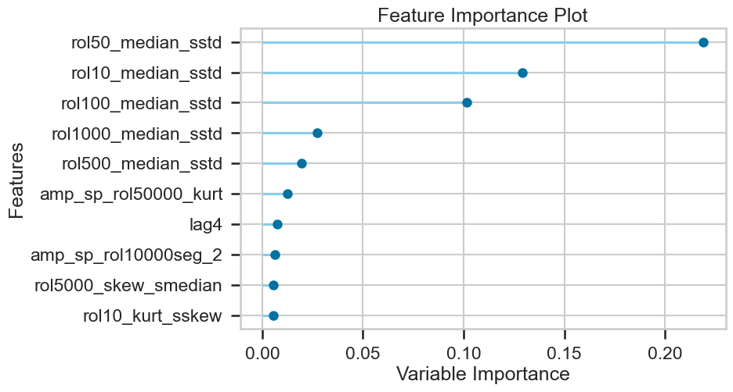
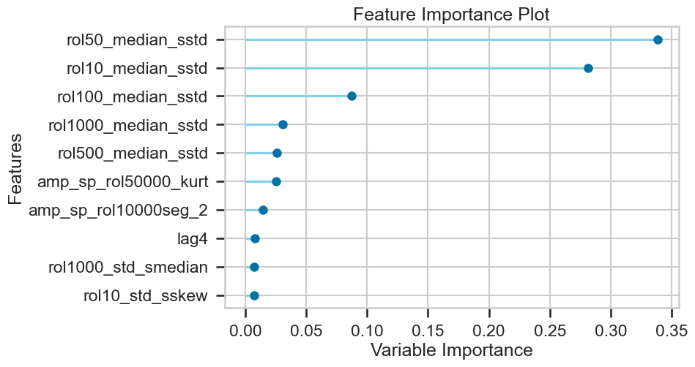
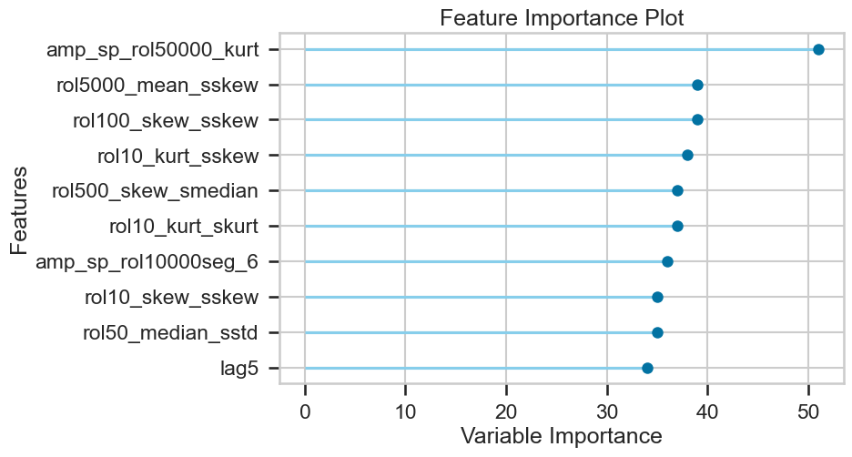
Feature importance
Random Forest
Gradient boost
RF and GB use similar features: Std after median filtering
Light GBM adopts a variety of features
Light GBM
Notes:
Tuned lightgbm

Slide 13
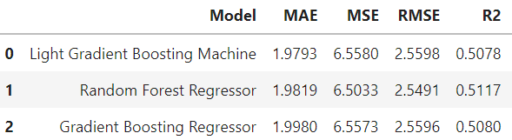


Voting regressor
Further implementing the wisdom of crowds
Voting regressor cross validation score
Notes:
A voting regressor is an ensemble meta-estimator that fits several base regressors, each on the whole dataset. Then it averages the individual predictions to form a final prediction.

Slide 14
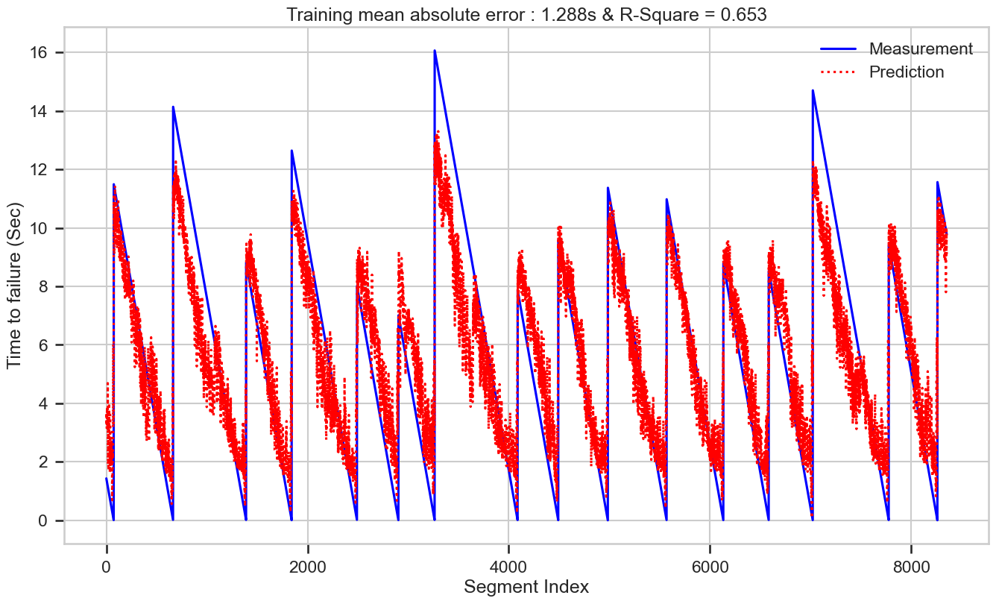
Predicted training
Training performance for 8400 segments
Overall trend captured
Deterministic values are challenging to capture

Slide 15
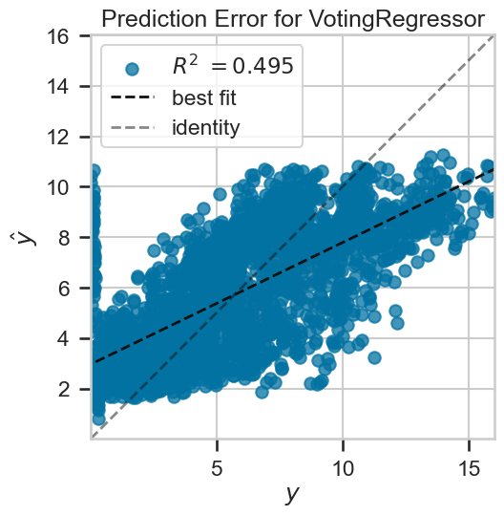
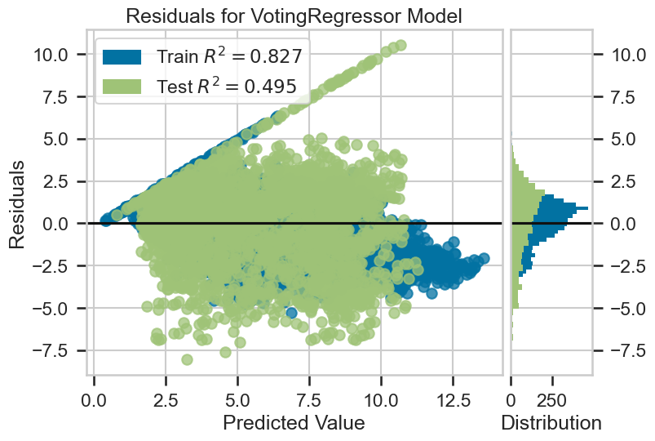
Errors on testing set
Prediction
Actual
Notes:
Blender

Slide 16
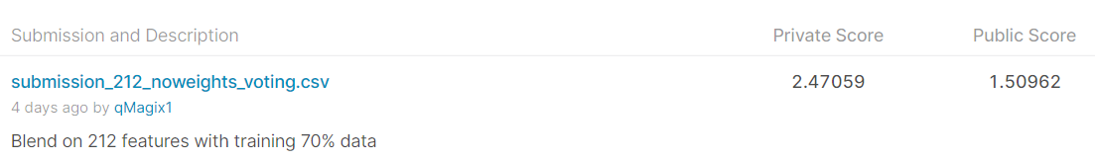
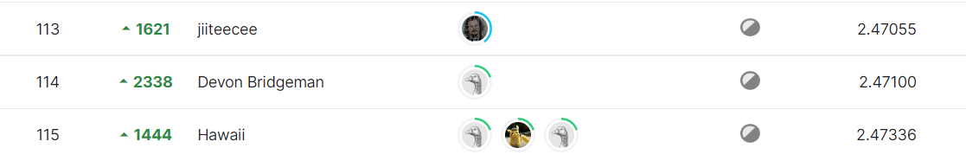
Kaggle ranking
(Better than 3% of private score Leaderboard on Kaggle)

Slide 17
Future work
Improve feature engineering
Employee the systematic error in validation
Deep/Recurrent neural network
Potential application
Cell phone app for the science lovers
Monitor storage site safety: nuclear waste, CO₂ reservoir

Slide 18
Conclusions
Engineered data from the acoustic data assist the prediction of the upcoming laboratory earthquake
Tree-based model and ensemble methods predict the trend of time-to-failure with a MAE of 1.970 s through learning the nonlinear relationship between the features and targets
Blending regressor further improves the tested MAE and R²

Slide 19
Acknowledgements
Los Alamos National Laboratory
Kaggle platform

Slide 20
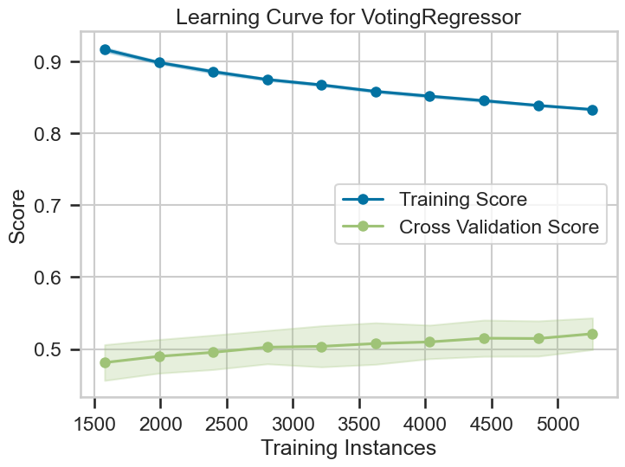
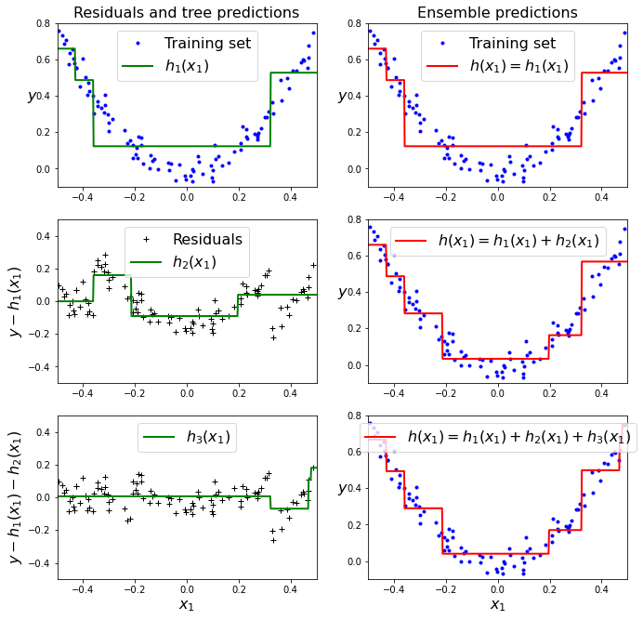
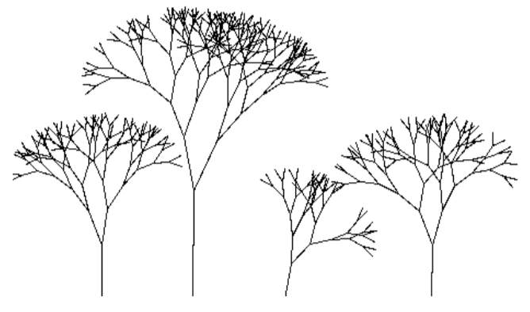
Workflow
Data Wrangling
Exploratory Data Analysis
Training
Tree-based model
Linear regression
Modeling

